Slide 1
University Attendance System
Guide by : Vishwas Raval
Harsh Kachhadiya - 2017033800104793
Ivankshu Vaghani - 2017033800105316
Vishal Pipaliya – 2017033800119637

Slide 2
Introduction
We try to implement this system as per our university. Main idea behind this project is to implement our paper based attendance to online.
University Attendance Management System is designed to automate the process of taking student attendance and generating attendance reports for the same.
Talking about traditional attendance system that we are following since many years but it does not show about customize attendance report.
Report of attendance will be done by the system itself so no more burden will be there on teacher also student see their attendance report easily.

Slide 3
Features
Manage faculty, department,course, class and subject records easily.
Manage credential of Department’s head, Teachers and Students.
Head of department also assign subject to teachers and assign elective subject to group of students.
Teacher take / update attendance or view / download attedance report easily.
Student can mark attendance using OTP or QR code and also allow to view / download attendance report easily.
System can generate and maintain all the updated data of attendance report.

Slide 4
Modules
Admin (Head of University)
Sub-Admin (Head of Department)
Teacher
Student

Slide 5
Admin (Head Of University)
Manage faculty and department details.
add/ edit/ delete faculty
add/ edit/ delete department
Manage credential of Teachers.
View/ download attendance report of student.

Slide 6
Sub-Admin (Head of Department)
Manage course, class and subject details
add/ edit/ delete course
add/ edit/ delete class
add/ edit/ delete subject
Manage credential of Students.
Assign subject to respective teachers.
Assign elective subject to particular group of students.
View/ download attendance report of student.

Slide 7
Teacher
Take attendance using OTP/OR code and manually.
Edit attendance manually also.
View/ download attendance report of particular class.

Slide 8
Student
Mark attendance by entering OTP or scanning QR code.
View/ download attendance report.

Slide 9
Technology
Front-end : ASP.NET, HTML, CSS, Bootstrap, JavaScript
Back-end: C#
Database : MS SQL 2017
IDE: Visual studio 2019

Slide 10
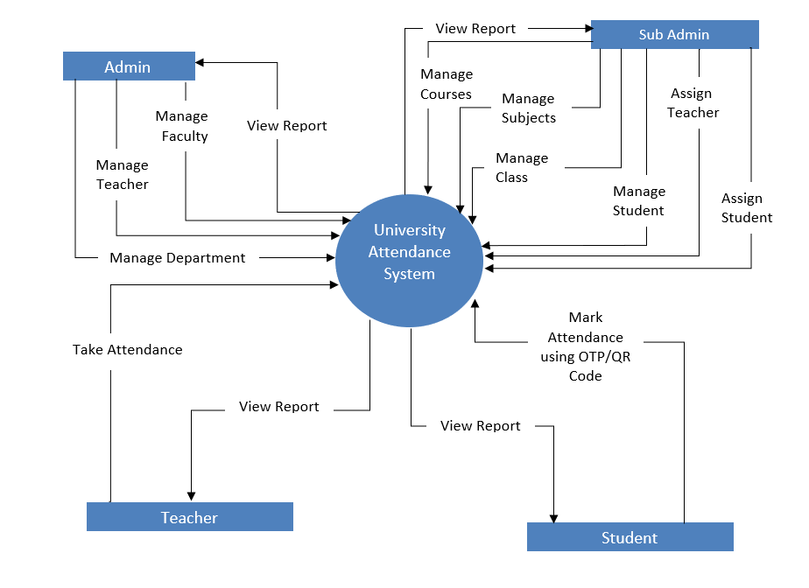
DFD Level– 0
Diagram
Notes:
<number>

Slide 11
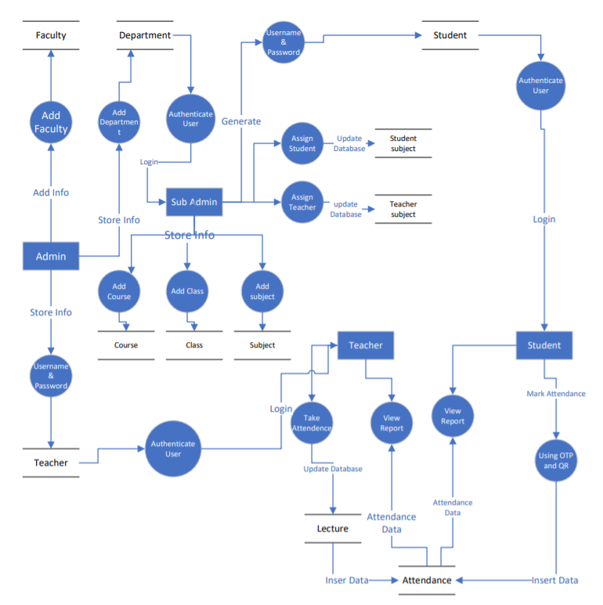
DFD Level– 1
Diagram
Notes:
<number>

Slide 12
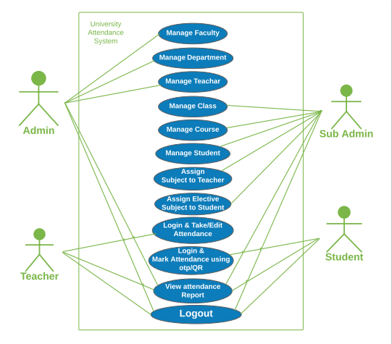
Use case Diagram

Slide 13
Sequence
Diagram

Slide 14
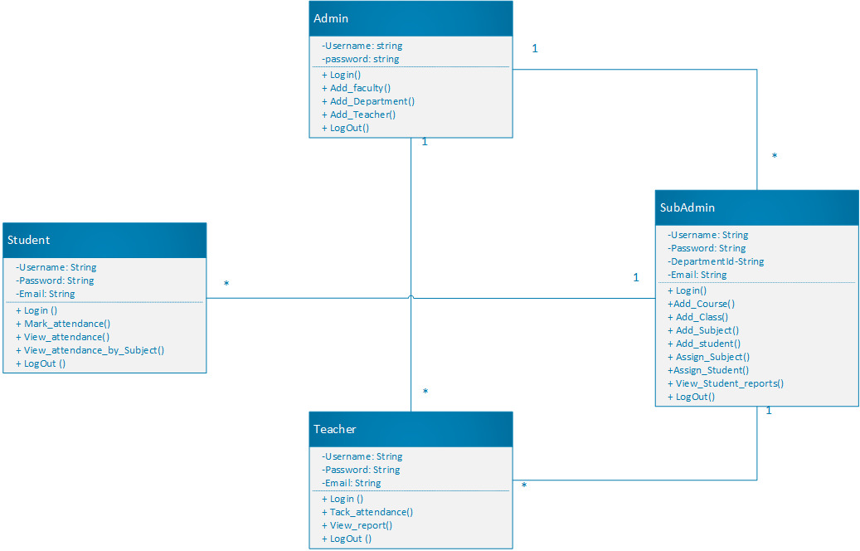
Class
Diagram

Slide 15
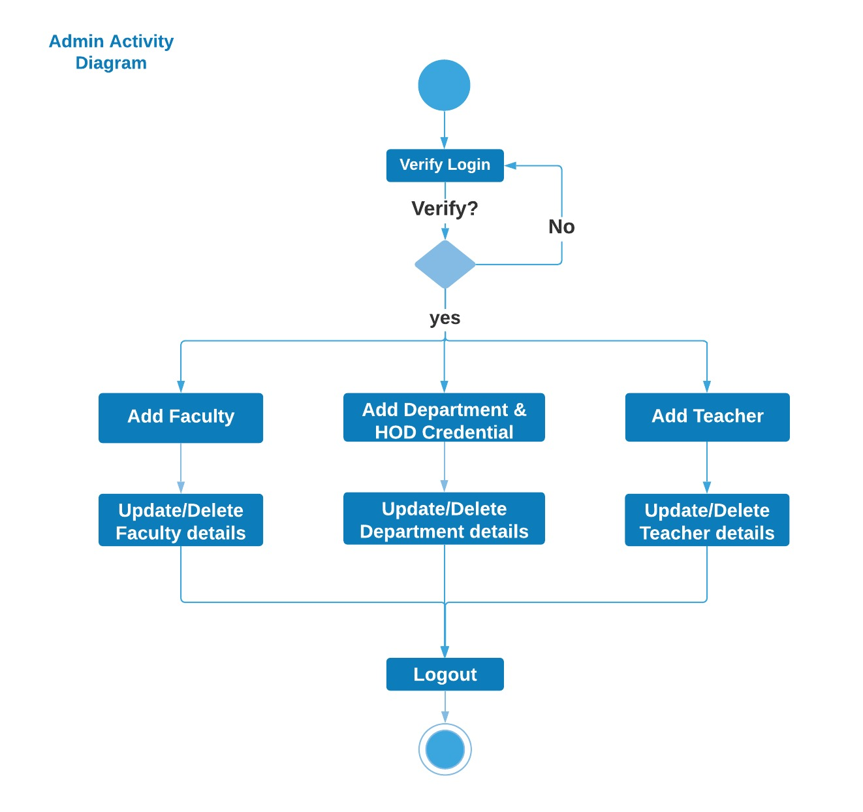
Admin
Activity
Diagram
Notes:
<number>

Slide 16
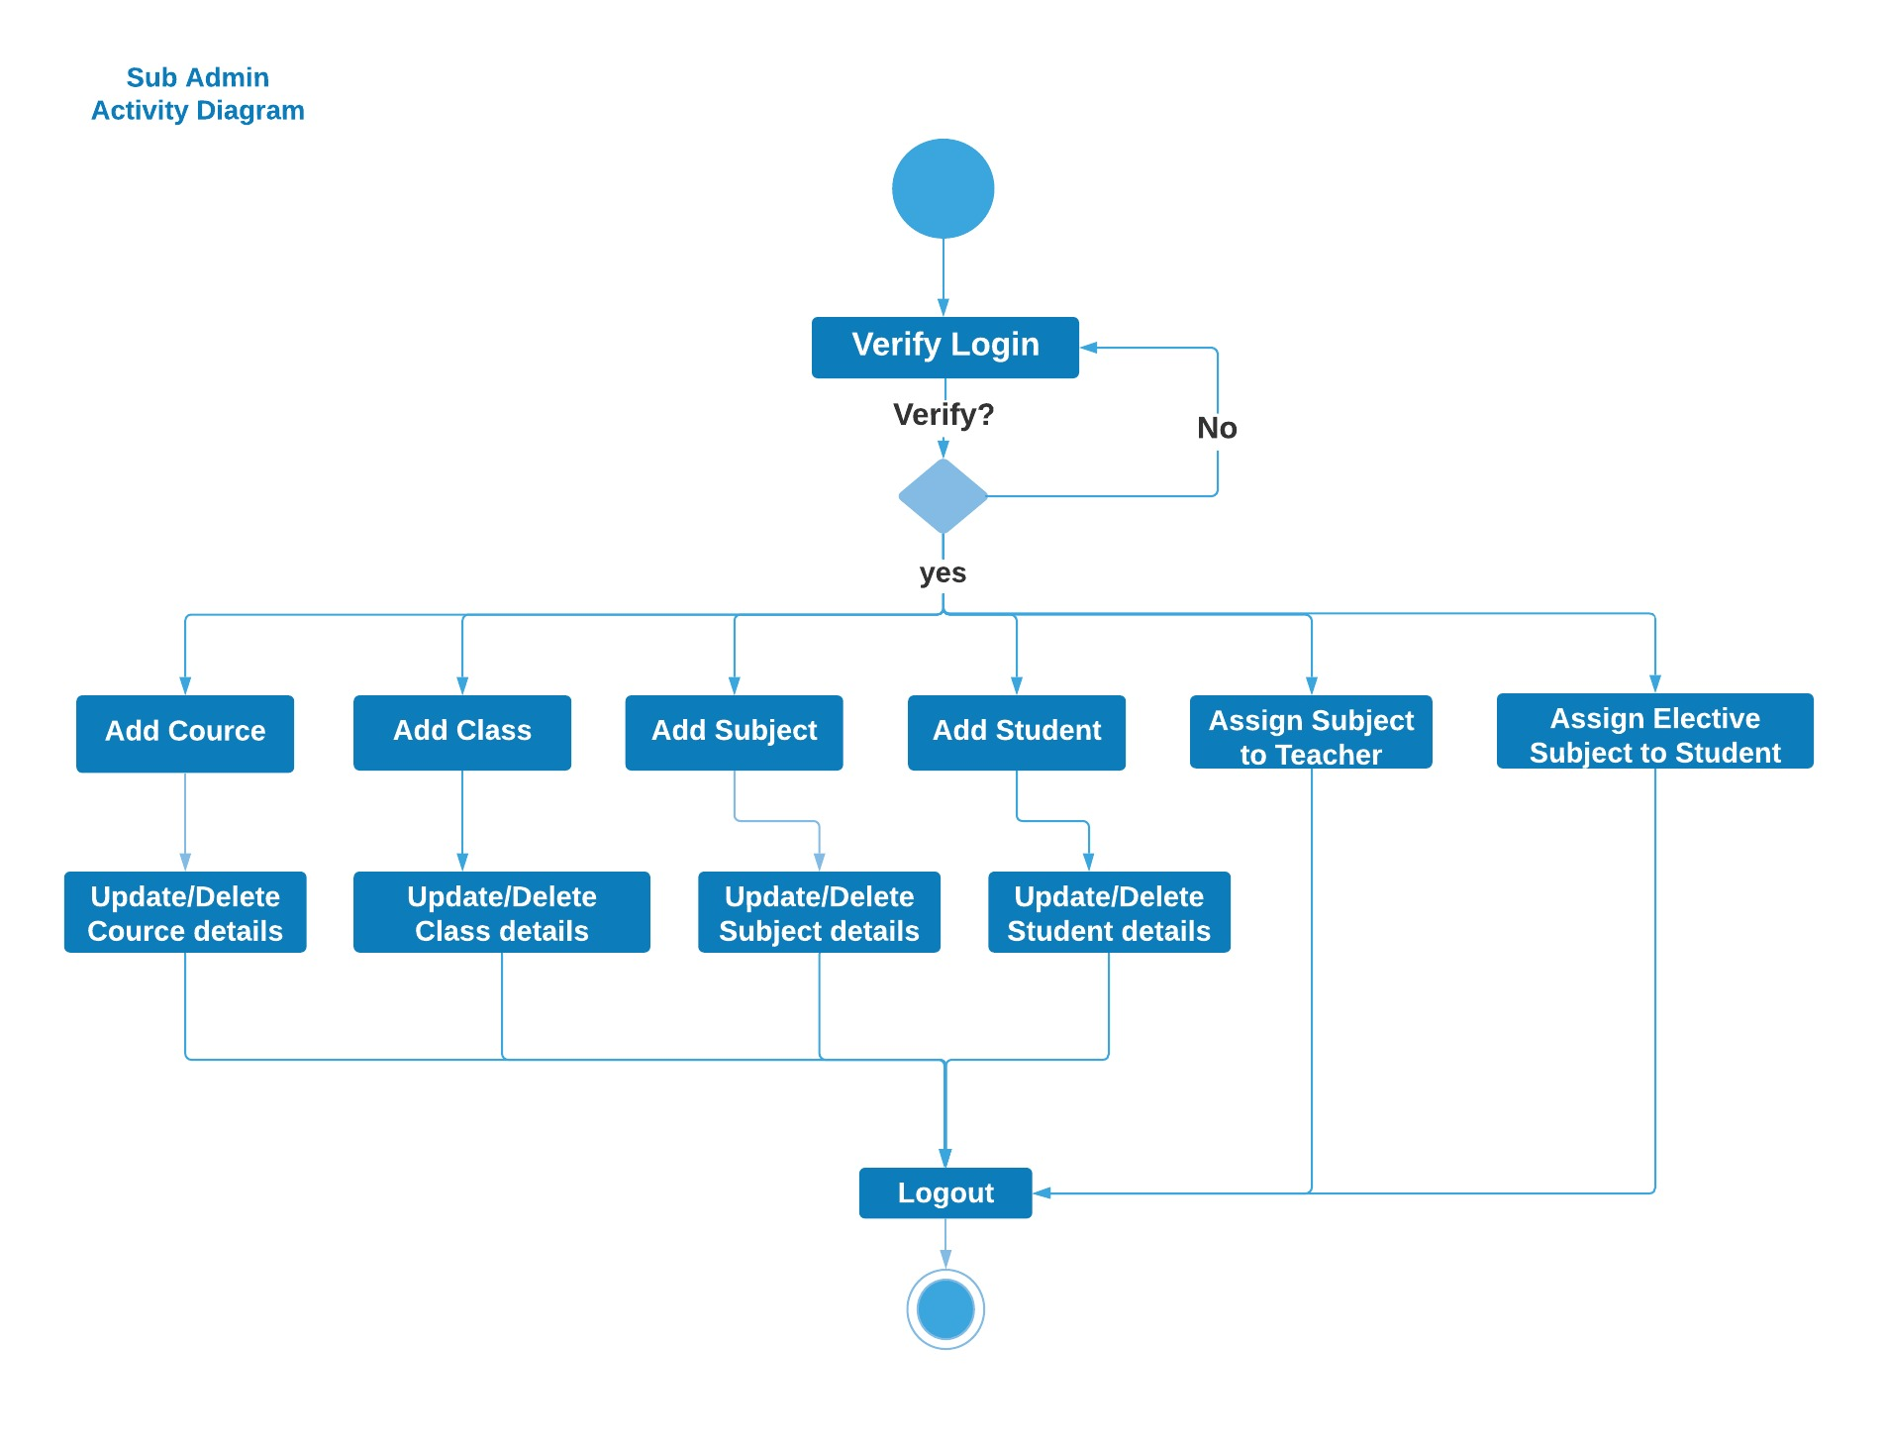
Sub-Admin
Activity
Diagram

Slide 17
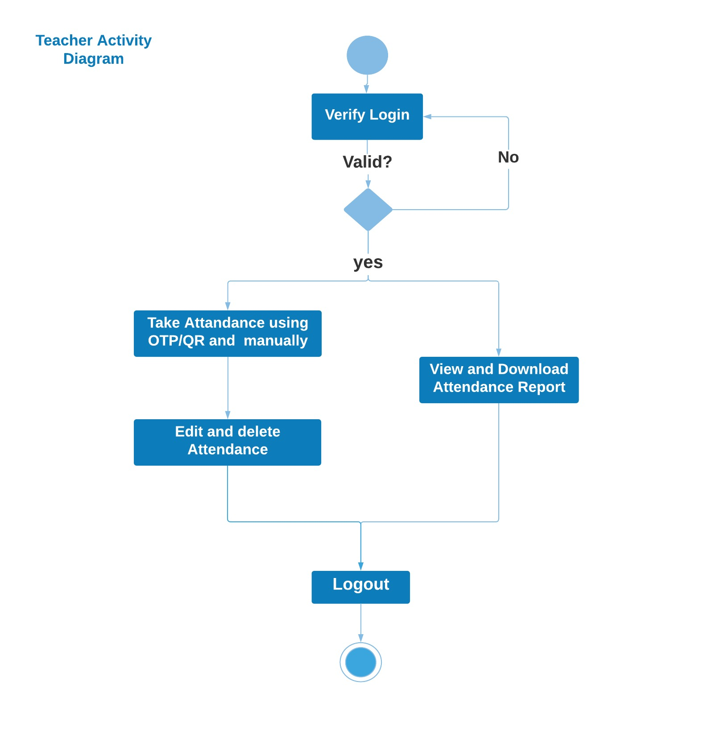
Teacher
Activity
Diagram

Slide 18
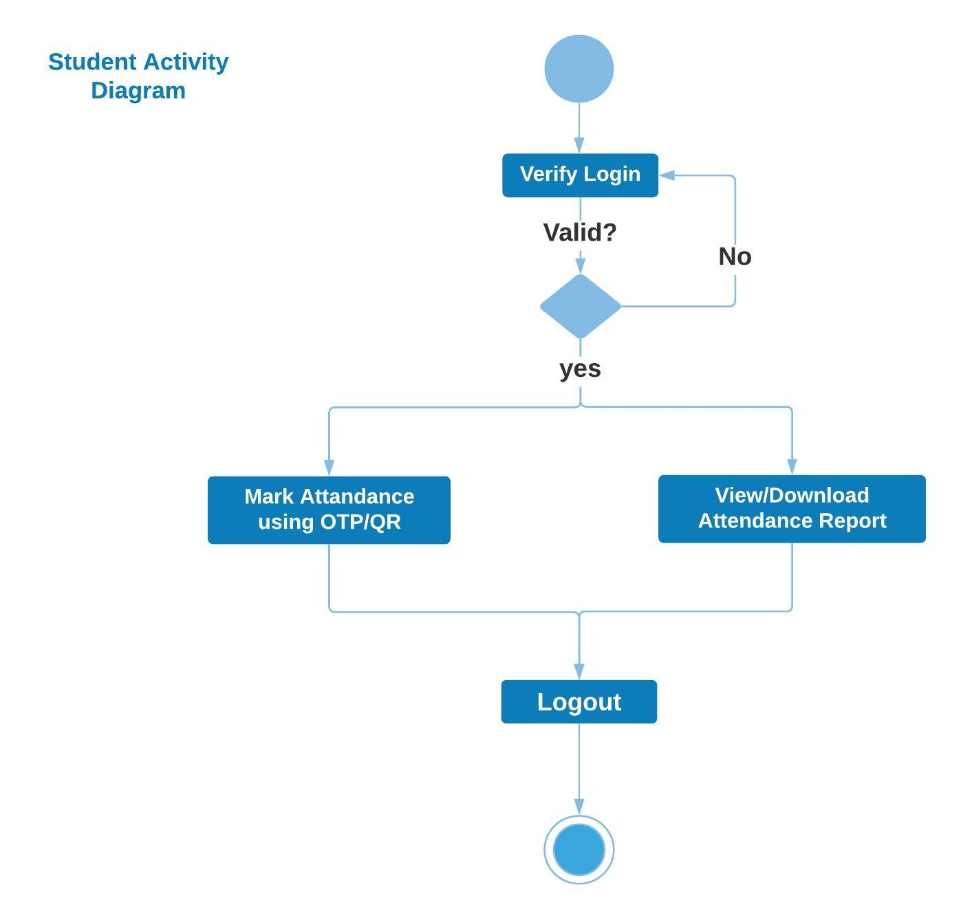
Student
Activity
Diagram

Slide 19
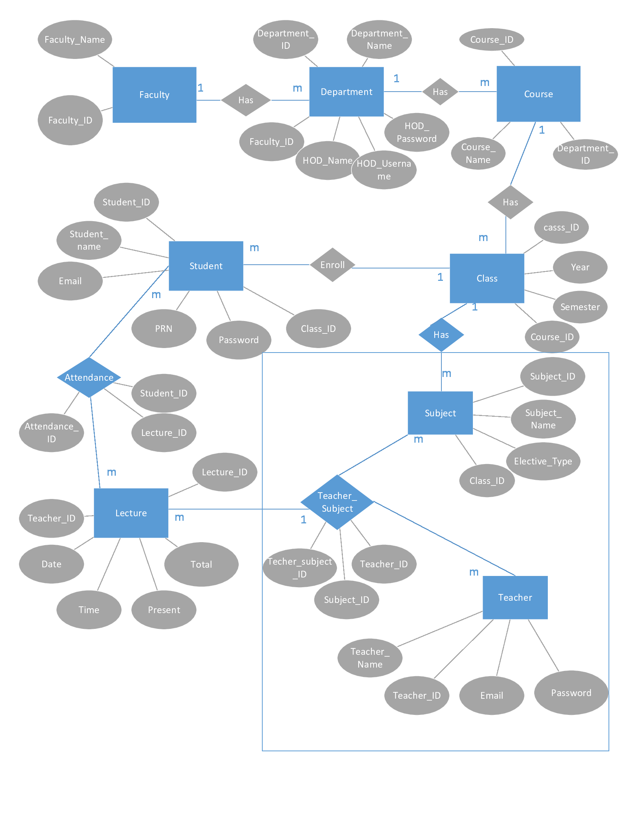
ER Diagram

